Slide 1

S.K PATEL INSTITUTE OF COMPUTER STUDE
MCA SEMESTER – I
MCA – 16
MINI PROJECT
TAAZA KHABER
STUDENT NAME | ROLL NUMBER | ENROLLMENT NUMBER
RANAVAYA HARSHAL | 53 | 24MCA02105
PATEL HIMANSHU | 39 | 24MCA02076

Slide 2
INTRODUCTION
An TAAZA KHABER News System refers to a platform or service that delivers news, articles, updates, and other information via the API and internet. This system allows users to access the latest news across various topics, including politics, entertainment, sports, technology, and more, in real-time, at their convenience. It has replaced traditional newspaper and broadcast media to a large extent, providing more interactivity, personalization, and timely delivery.

Slide 3
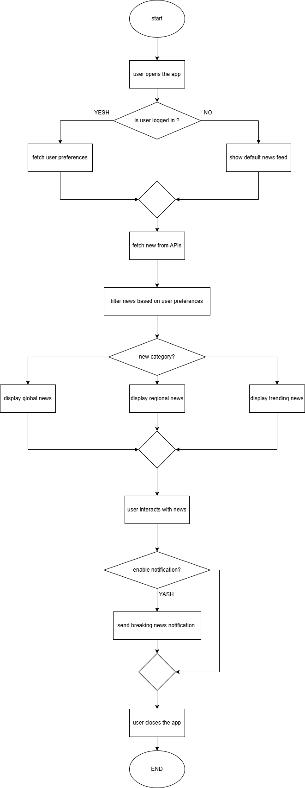
FLOWCHART :

Slide 4
DRAWBACKS:
aspect | Aaj tak | India today
Regional focus | ❌ Overlay focused on India news | ❌Primarily Indian centric
Global coverage | ❌Minimal global news coverage | ❌Limited global focus
Multi-language support | ❌Limited to Indian language only | ❌Only support English and hindi
Ui/Ux | ❌Feels cluttered and ad-heavy | ❌Slightly ad-heavy, can feel over whelming
Offline support | ❌Doesn’t support offline read | ❌Limited to premium app features

Slide 5
ANALYSIS
FACT FINDING METHOD
FEATURE | AAJ TAK | INDIA TODAY
Regional lang support | ✅ | ✅
Live tv/ streaming | ✅ | ✅
Multi language content | ✅ | ✅
Breaking news alerts | ✅ | ✅
Video news coverage | ✅ | ✅

Slide 6
FEASIBILITY STUDY
TECHNICAL FEASIBILITY
News api for global news custom apis/rss for Indian news
React , node, express ,MySQL
Use google translate api pre translated feeds regional support
Youtube api for videos , and push notifications

Slide 7
Economic Feasibility
App design and development.
Server and database setup.
Licensing for APIs or third-party tools.
Operational Feasibility
Developers, designers, and testers for app creation.
Content curators and moderators for news verification.
Marketing team for user acquisition.

Slide 8
Scheduling Feasibility
Prototype: 2-3 months.
Full-scale development: 6-8 months.
Testing and launch: 2 months.

Slide 9
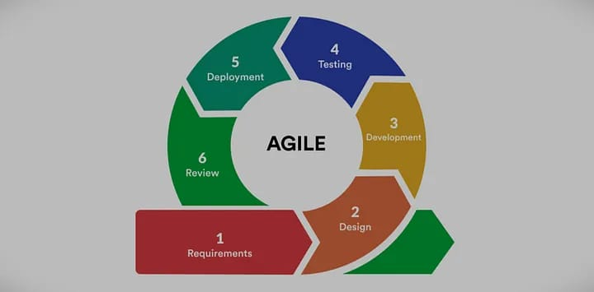
Process model

Slide 10
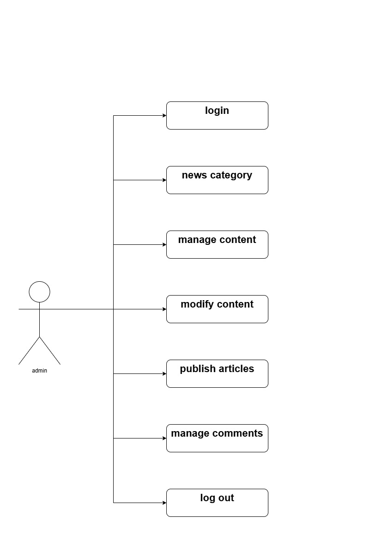
Use case admin diagram

Slide 11
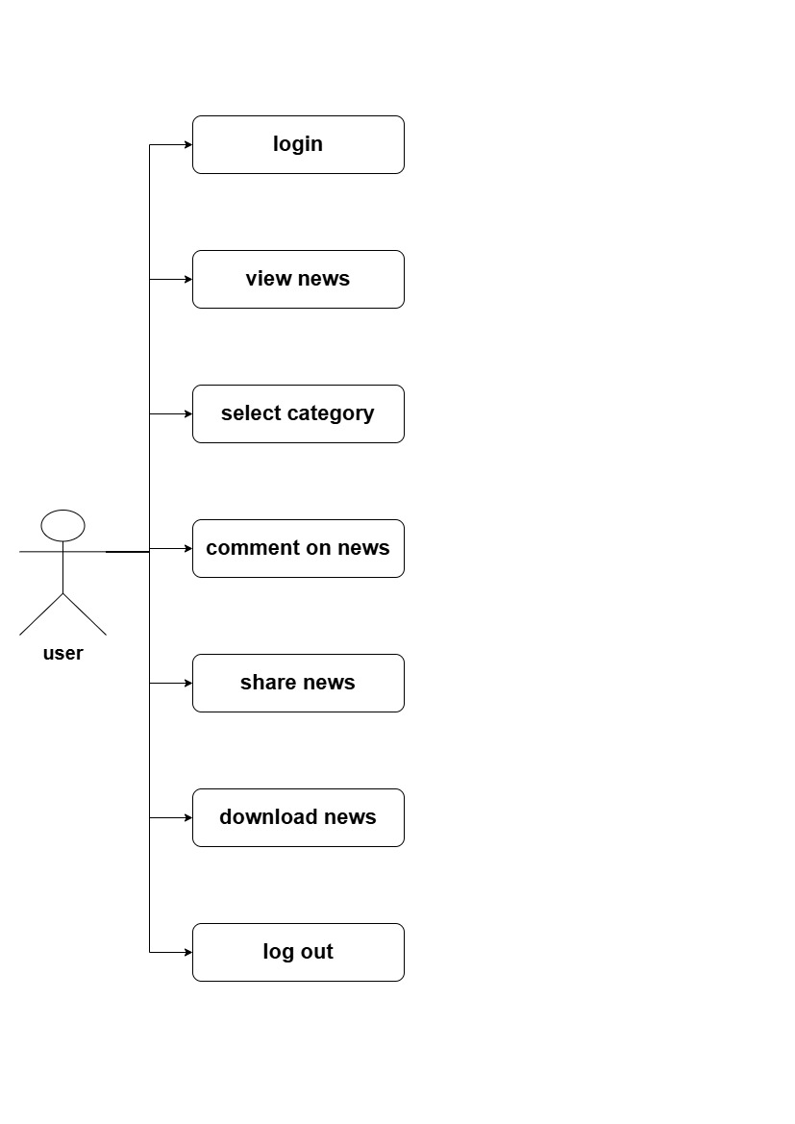
Use case user diagram

Slide 12
User :
Field Name | Datatype | Field Size | Constraints | Description
userId | INT | 11 | PRIMARY KEY | Unique identifier each user
username | VARCHAR | 255 | NOT NULL, UNIQUE | User's login name
password | VARCHAR | 255 | NOT NULL | User's password
email | VARCHAR | 255 | NOT NULL, UNIQUE | User's email address
Admin :
Field Name | Datatype | Field Size | Constraints | Description
adminId | INT | 11 | PRIMARY KEY | Unique identifier for each admin
username | VARCHAR | 255 | NOT NULL, UNIQUE | Admin's login name
password | VARCHAR | 255 | NOT NULL | Admin's password

Slide 13
Article :
Field Name | Datatype | Field Size | Constraints | Description
articleId | INT | 11 | PRIMARY KEY | Unique identifier for each article
title | VARCHAR | 255 | NOT NULL | Title of the article
content | TEXT | - | NOT NULL | Main content of the article
author | VARCHAR | 255 | NOT NULL | Author of the article
publishedDate | DATE | - | NOT NULL | Date of article publication
categoryId | INT | 11 | FOREIGN KEY | Foreign key to the Category table
Comment :
Field Name | Datatype | Field Size | Constraints | Description
commentId | INT | 11 | PRIMARY KEY | Unique identifier for each comment
content | TEXT | 11 | NOT NULL | Content of the comment
userId | INT | 11 | FOREIGN KEY | Foreign key to the User table
articleId | INT | 11 | FOREIGN KEY | Foreign key to the NewsArticle table
status | ENUM | ('approved', 'rejected') | NOT NULL | Approval status of the comment

Slide 14
Notification :
Field Name | Datatype | Field Size | Constraints | Description
notificationId | INT | 11 | PRIMARY KEY | Unique identifier for each notification
userId | INT | 11 | FOREIGN KEY | Foreign key to the User table
message | TEXT | 255 | NOT NULL | Content of the notification
timestamp | DATETIME | - | NOT NULL | Time when the notification was sent
Category :
Field Name | Datatype | Field Size | Constraints | Description
categoryId | INT | 11 | PRIMARY KEY | Unique identifier for each category
name | VARCHAR | 255 | NOT NULL | Name of the category
description | TEXT | 255 | NULLABLE | Description of the category

